Slide 1
EC 101
Teaching Students with Disabilities

Slide 2
Purpose
Increase awareness and understanding of Exceptional Children (EC) procedures

Slide 3
IDEIA
IDEIA is our nation’s special education law.
IDEIA stands for Individuals with Disabilities Education Improvement Act
The concept that every child is entitled to a free, appropriate public education (FAPE) is central to IDEIA.
Notes:
First special education law was Public Law 94-142, Education for All Handicapped Children, enacted in 1975. IDEA was reauthorized in 2004, it is now called IDEIA.

Slide 4
Eligibility Process
Regular education interventions implemented.
Parents, school personnel, students or others may make a request for evaluation to an IEP team meeting.
Parent permission is given in writing for an evaluation.
A team of qualified professionals review the results of the evaluation with the parent at an IEP team meeting to determine if the child is eligible for special education services.
If the student is eligible, an IEP is developed annually.
A reevaluation must occur every three years.
Notes:
If a student is found eligible, the parent must sign a consent for placement. If a parent does not sign, services cannot be provided. IEP teams determine the assessments to be conducted for a reevaluation.

Slide 5
Areas of Eligibility
Autistic
Behaviorally/Emotionally Disabled
Deaf/Blind
Developmentally Delayed
Hearing Impaired
Educable Mentally Disabled
Trainable Mentally Disabled
Severely/Profound Disabled
Multi-Handicapped
Orthopedically Impaired
Other Health Impaired
Specific Learning Disabled
Speech/Language Impaired
Traumatic Brain Injured
Visually Impaired
Notes:
These are the 15 areas of eligibility in the state of North Carolina. The highlighted areas of the most common found in general education classes. It is also important to note that 85% of students with disabilities have average or above average cognitive ability.

Slide 6
Individualized Education Plan (IEP)
Guides the delivery of special education supports and services for the student with a disability
Legal document that teachers must implement—”It is the cornerstone of a quality education for each child with a disability” US Dept of Education
Ensures educational opportunity for students with disabilities
Requires team work: LEA Representative, Regular Ed. Teacher, Special Ed. Teacher, Parent and Student (if 14 or older)
Developed annually
IEP at a Glance
Notes:
An IEP must be implemented as written. Accommodations and modifications must be provided as written. Changes to an IEP can be made at any time with an IEP team meeting, it must be reviewed at rewritten at a minimum of once a year. IEP at Glance should be given to every teacher that works with the student.

Slide 7
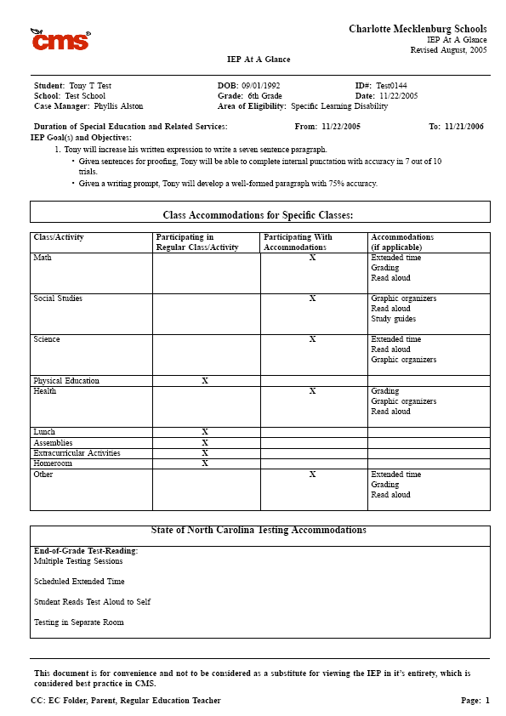
Notes:
This should be given to every teacher that works with the student. Teachers are required to provide the accommodations listed. Every teacher that works with the student must implement the IEP as written.

Slide 8
Levels of Service
Regular Level
Consultative
Up to 20% of the day in an EC class
Resource Level
20% to 60% of the day in an EC class
Separate
More than 61% of the day in an EC class
Block
Self-Contained: SBS, SAC, AU, HI, OI and LifeSpan
Notes:
The level of service is determined by the amount of time a student is removed for general education classes. Regular level of service includes co-taught classes. All schools are excepted to provide separate level of service for students following the Standard Course of Study that do not require a SBS program. Block separate means all core academic classes are taught in an EC class. Self-contained programs: SBS- Specialized Behavior Support, SAC- Specialized Academic Content, AU- Autistic, OI- Orthopedically Impaired. SAC and AU classes teach the Extended Content Standards

Slide 9
That’s Not Fair
Children, in their initial stages of moral development, define 'fairness': “Fairness means that everyone gets the same.”
The true definition of fairness is: “Fairness means that everyone gets what he needs.”
Richard D. Lavoie, M.A., M.Ed
Notes:
This leads into accommodations and modifications. Accommodations and modifications are meant to level the playing field, not give students an advantage.

Slide 10
Classroom Accommodations
Grading
Modified Assignment
Alternative Materials
Graphic Organizers
Student Marks in Book
Read Aloud
Extended Time
Portfolio
Large Print
Audio Tapes
Study Guides
Preferential Seating
Test in Separate Room
Crammer-Abacus
Dictation to Scribe
Magnification Devices
Interpreter
Multiple Test Sessions
Assistive Devices
Other
Notes:
This is the state approved list of classroom accommodations. It is not a laundry list to pick form. The accommodations should be related to the disability. How the accommodations will be used should be explained in the IEP. If grading is selected, what does that mean? How will the assignments be modified? The accommodations provided in the classroom should match the modifications given for state testing.

Slide 11
Testing Modifications
Testing in Separate Room
One Test Item Per Page
Braille/Braillewriter
Magnification Devices
Interpreter
Assistive Devices
Computer/Typewriter/ Word Processor
Read Aloud
Student Reads Test to Self
Extended Time
Large Print Test
Dictation to Scribe
Student Marks in Book
Multiple Testing Sessions
Notes:
These are for state tests. These modifications should regularly occur in every day instruction. The details of how the modifications will be implemented should be explained in the IEP.

Slide 12
Day to Day Implementation of Accommodations/Modifications
Classroom Assignments, Homework and Tests
Quarterly Testing
End of Grade/Course Testing

Slide 13
Questions

